Slide 1
Paying by Donating: Corporate Donations Affiliated with Independent Directors
Ye Cai
Leavey School of Business, Santa Clara University
Jin Xu
Pamplin College of Business, Virginia Tech
Jun Yang
Kelley School of Business, Indiana University
The Review of Financial Studies
Apr 2020
Presented by: Yan Li

Slide 2
Research Goal
This paper explores a new determinant of director independence: material relationships between independent directors and top executives via corporate charitable contributions to tax-exempt organizations affiliated with independent directors (affiliated donations).

Slide 3
Related Literature
The monitoring role of independent directors on corporate boards has long been a topic of interest in the corporate governance literature (Weisbach 1988; Hermalin and Weisbach 1998; Core, Holthausen, and Larcker 1999).
This paper is tied to the growing literature examining whether corporate spending on CSR improves firm value (Edmans 2011; Flammer 2015) or satisfies CEOs’ personal preferences to the detriment of shareholders (Friedman 1970; Cheng, Hong, and Shue 2016). However, the CSR literature does not examine how CEOs benefit personally from building relationships with independent directors by channeling corporate funds to director-affiliated charities.

Slide 4
Data Description and Univariate Analysis
BoardEx database: director data
ExecuComp: CEO compensation information
Foundation Directory Online (FDO) at https://fconline.foundationcenter.org/: corporate charitable donations
sportingnews.com, cbssports.com, collegesportsinfo.com, coachesbythenumbers.com, and Wikipedia: college basketball and football coach turnovers
Final sample: 3,746 firm years from 444 unique S&P 500 firms that are nonforeign and have all of the information required for analyses
Sample Period: from 2003 to 2012

Slide 5
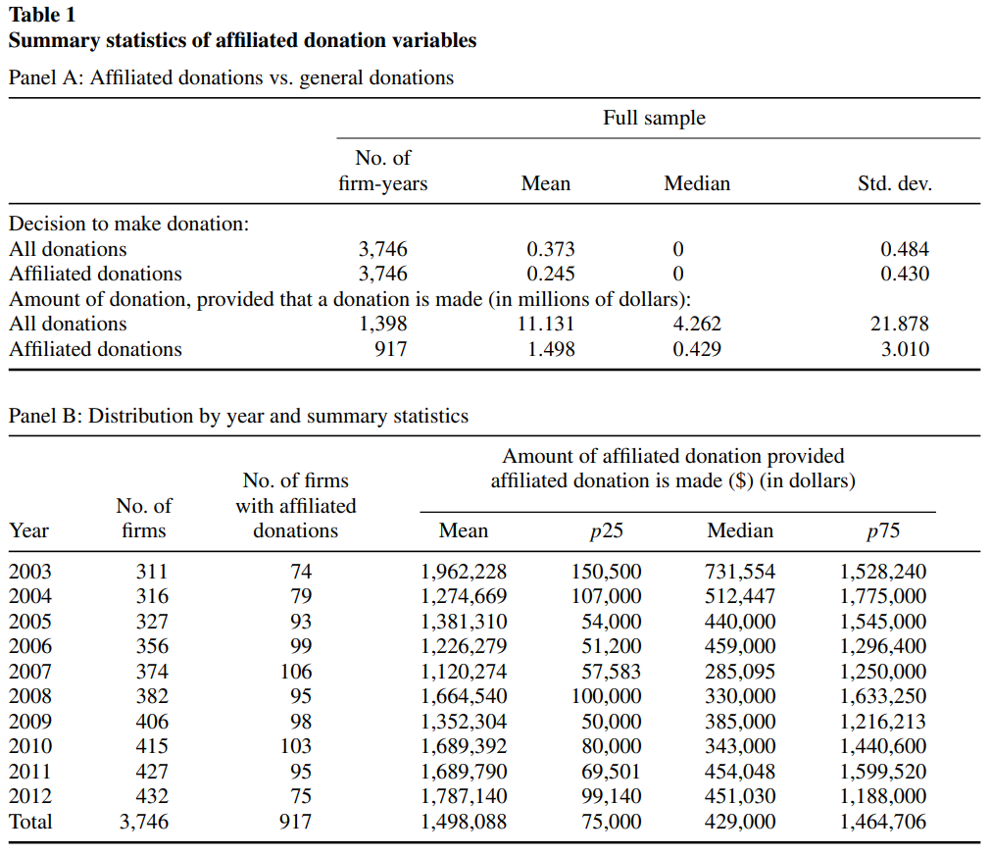
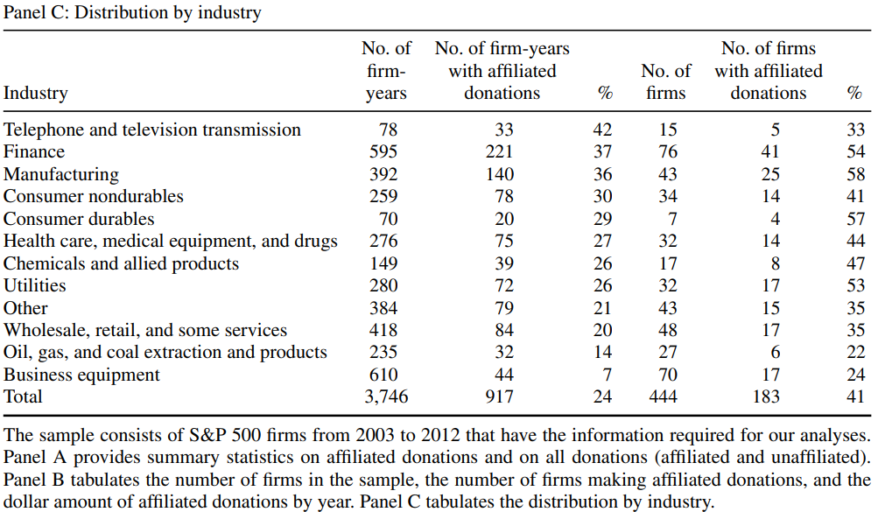
Data Description and Univariate Analysis
Notes:
Panel A: 1,398 out of 3,746 firm-year observations (37.3%) in sample make charitable contributions (of at least $5 million in total giving), and the average amount is $11.1 million provided that a donation is made. Approximately two-thirds of the donating firm-years (917 firm-year observations, 24.5% of the sample) contribute to charities affiliated with their independent directors. The average affiliated donation amount for each firm year is $1.5 million, and these donations are affiliated with three independent directors on average.
Panel B shows the occurrence and amount of affiliated donations by year. The highest level occurs in 2003.
Panel C: Manufacturing, consumer nondurables, and finance are the top three industries based on the number of firms making affiliated donations.

Slide 6
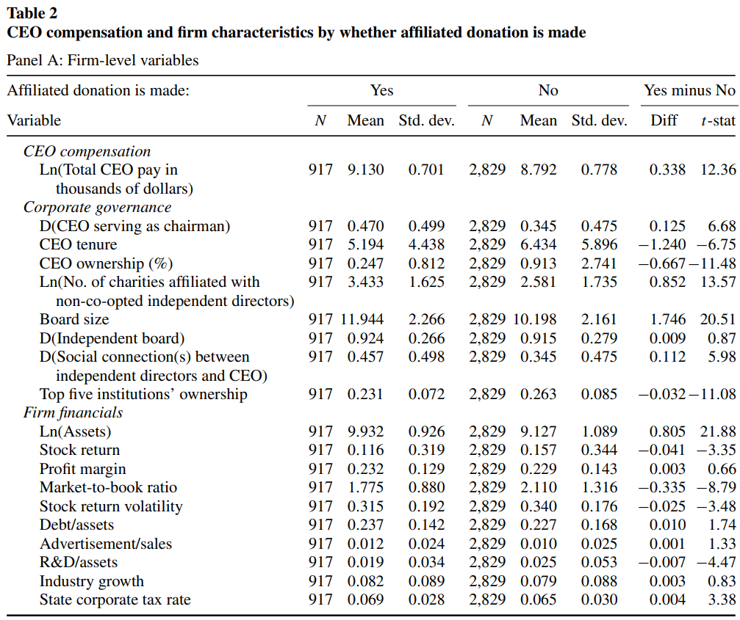
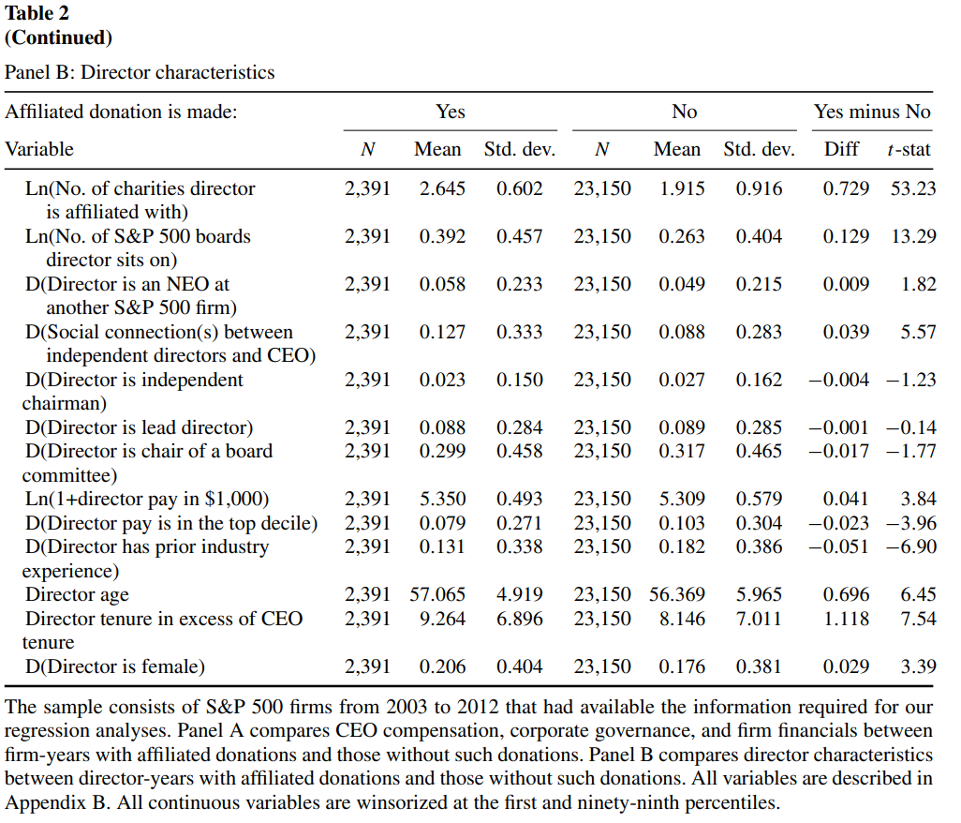

































Data Description and Univariate Analysis
Notes:
Panel A compares firms that make affiliated donations with firms that do not. Panel B compares directors whose affiliated charities have received one or more donations from the firms on whose boards they serve with those whose charities have not received any such donations.
CEOs of donating firms receive greater total annual pay. They are more likely to serve as the chairman of the board, have a shorter tenure as CEO, and own a smaller fraction of the firm’s equity. When non-co-opted independent directors are affiliated with more charities, firms are more likely to make affiliated donations.
A CEO whose appointment was approved by these longer-tenured independent directors has a stronger incentive to gain leverage over the directors via charitable donations to their affiliated charities. Firms making affiliated donations tend to have larger boards, more social connections between independent directors and the CEO, and lower ownership by the top five institutional investors.
Overall, firms with weak corporate governance are more likely to make affiliated donations. Moreover, we show that firms making affiliated donations tend to be larger (by book value of assets), have inferior stock performance (lower stock returns and market-to-book ratio),

Slide 7
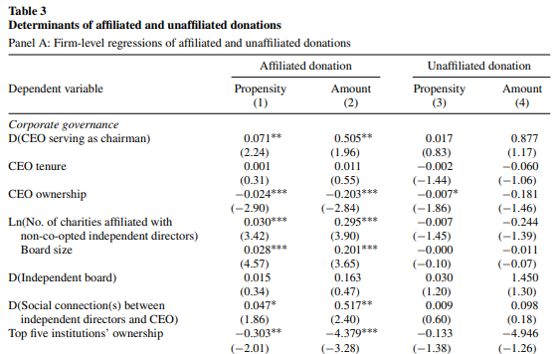
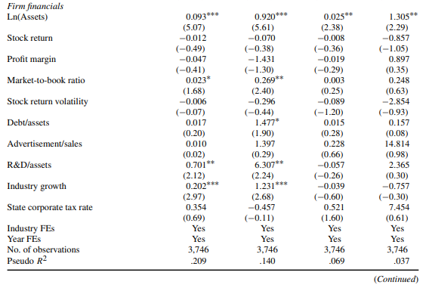
Determinants of affiliated donations in a level specification
Notes:
Panel A: firms with lower CEO ownership and a larger board are more likely to make affiliated donations and to donate larger amounts. If long-tenured independent directors have more charity affiliations, firms are more likely to donate to these charities and make larger donations. In addition, firms are more likely to make affiliated donations and donate more when independent directors have social connections to the CEO and when the top five institutional investors own a smaller percentage of the company.
Firm size, market-to-book ratio, R&D investment, and industry growth are positively correlated with the likelihood and amount of affiliated donations. In addition, the amount of affiliated donations increases with financial leverage. In contrast, only firm size is positively correlated with the likelihood and amount of unaffiliated donations, perhaps because large firms have more resources for charitable causes

Slide 8
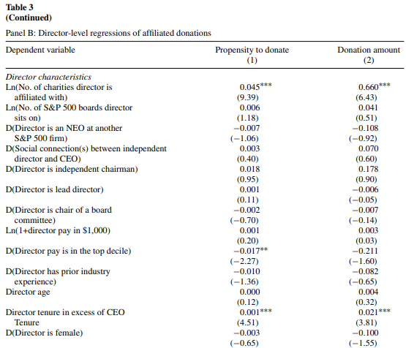
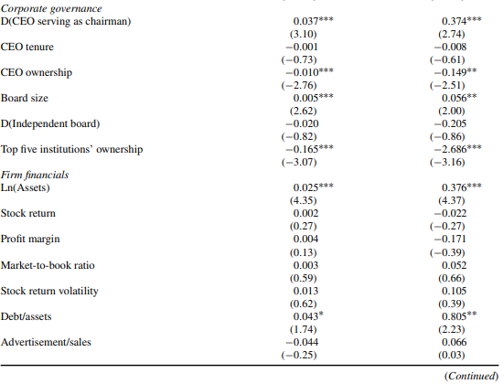















Determinants of affiliated donations in a level specification
Notes:
Panel B shows that the likelihood and size of affiliated donations are greater for independent directors who are affiliated with more charities and for those who have been serving on the board longer than the CEO has been in the corner office (variable: director tenure in excess of CEO tenure). Both findings suggest that CEOs tend to use charitable giving to gain bargaining power over influential independent directors.
Director pay is not correlated with affiliated donations. The likelihood of receiving affiliated donations is lower if the independent director’s pay is in the top decile. Firms with weaker corporate governance (CEO serves as chairman, lower CEO ownership, lower ownership by the top five institutional investors, and a larger board) are more likely to donate and make larger donations to charities affiliated with independent directors.

Slide 9
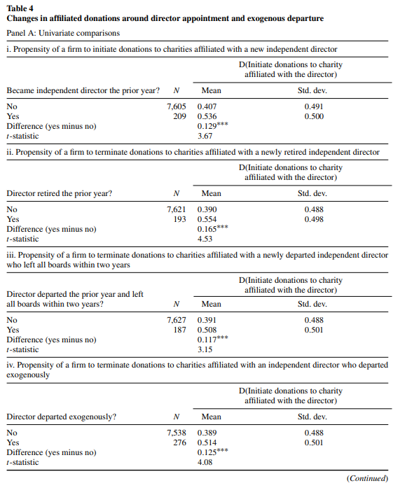




Changes in affiliated donations around directors’ appointments and exogenous departures
Notes:
Panel A summarizes changes in donation propensities around director appointment and director departure. The probability of initiating affiliated donations is 12.9 percentage points higher in the year after the director’s first appointment to the board that establishes the first connection between the firm and the charity than the baseline probability of 40.7% for other independent directors.
Conversely, the likelihood of terminating affiliated donations is 16.5 percentage points higher in the year after a director retires and severs the connection between the firm and the charity than the baseline probability of 39.0% for other independent directors. The likelihood of terminating affiliated donations is 11.7 percentage points higher in the year after a director suddenly departs than the baseline probability of 39.1% for other independent directors. Finally, the likelihood of terminating affiliated donations is 12.5 percentage points higher after the exogenous departure of an independent director than the baseline probability of 38.9% for other independent directors.

Slide 10
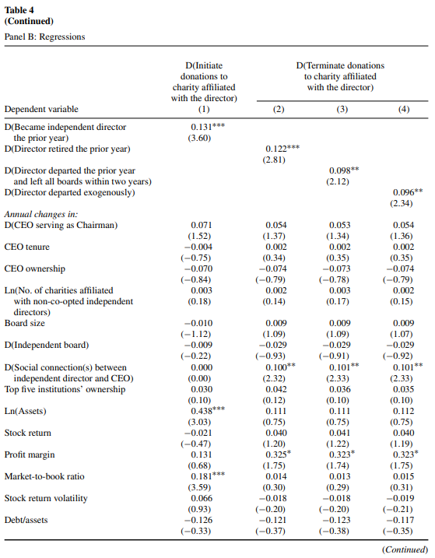
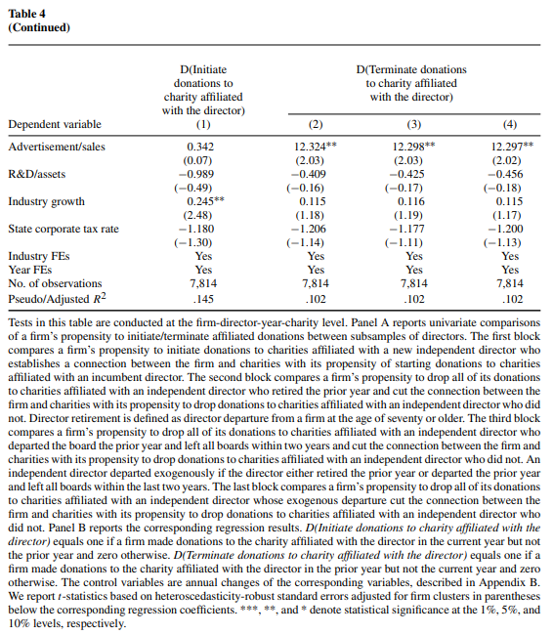
Changes in affiliated donations around directors’ appointments and exogenous departures
Notes:
These results are robust to the addition of controls for annual changes in governance and firm characteristics in multivariate regressions (panel B). Overall, corporate charitable donations tend to follow directors’ moves, consistent with the notion that top executives use charitable contributions to influence independent directors’ monitoring decisions

Slide 11
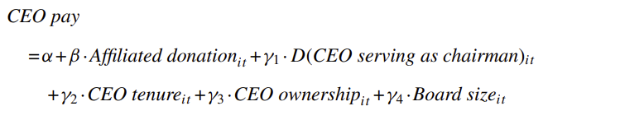
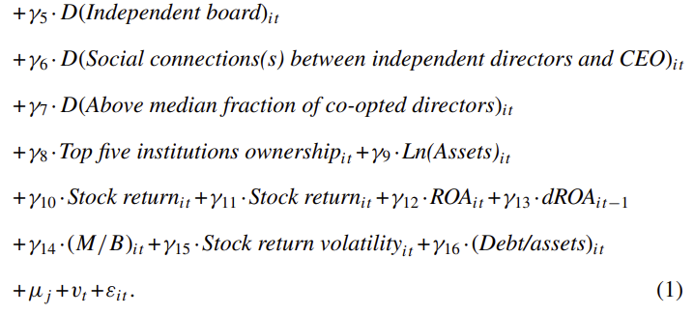
Effect of Affiliated Donations on CEO Compensation

Slide 12
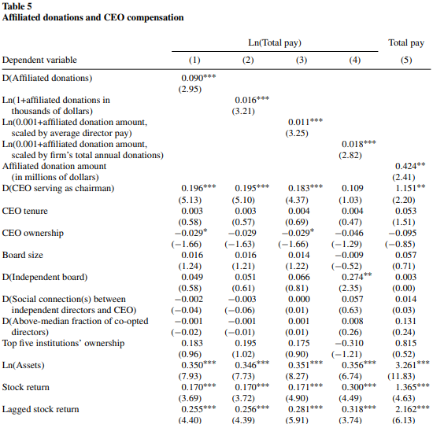
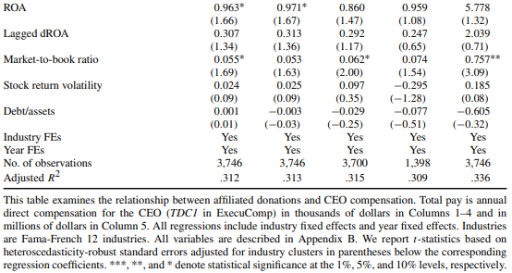
Effect of Affiliated Donations on CEO Compensation
Notes:
The dependent variable is the logarithm of total annual compensation (TDC1 in ExecuComp) in thousands of dollars in Columns 1–4 and TDC1 in millions of dollars in Column 5.

Slide 13
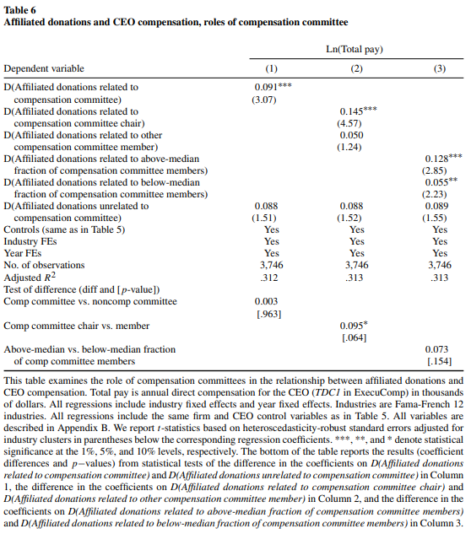
The compensation committee channel
Notes:
CEOs earn 9.5% (=exp(0.091)-1) more on average at firms that donate to charities affiliated with compensation committee members than at firms not making affiliated donations. In contrast, the correlation between CEO compensation and affiliated donations unrelated to the compensation committee is statistically insignificant.

Slide 14
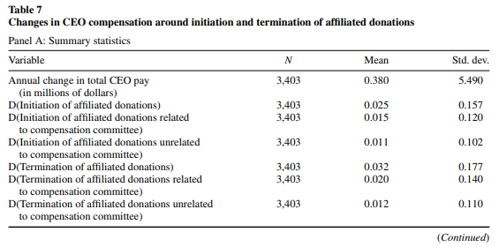






Changes in CEO compensation when firms commence and terminate affiliated donations
Notes:
Panel A of Table 7 reports the summary statistics of the main variables. The average annual change in CEO pay is $380,000. In 2.5% of the firm-year observations, affiliated donations are initiated; in 3.2% of the observations, they are terminated.

Slide 15
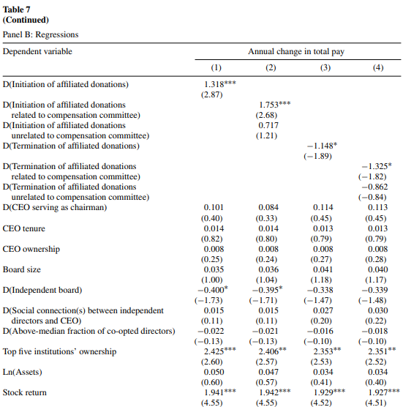
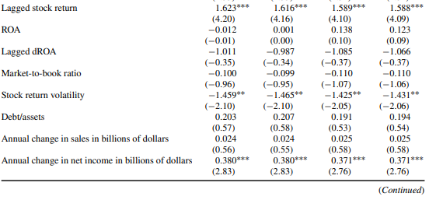
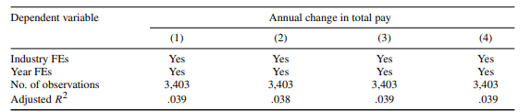




Changes in CEO compensation when firms commence and terminate affiliated donations
Notes:
Panel B reports the regression results. When a firm initiates affiliated donations, the increase in CEO pay is $1.3 million higher than in other years (Column 1). This is driven by cases in which the firm initiates affiliated donations involving its compensation committee members (Column 2). When a firm terminates all of its affiliated donations, the change in CEO pay is $1.1 million lower than in other years (Column 3); this result is also driven by cases in which the firm terminates affiliated donations involving its compensation committee members (Column 4).

Slide 16
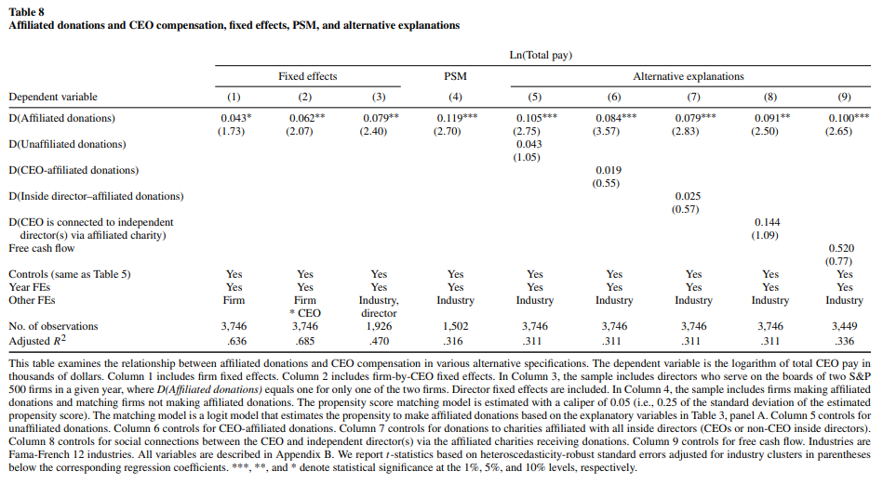



Fixed effects, propensity score matching, and alternative explanations
Notes:
Column1: replace industry fixed effects with firm fixed effects
Column2: includes firm and CEO interactive fixed effects that control for time-invariant firm and CEO characteristics that may drive the variations in affiliated donations and CEO compensation
Column3: examines the possibility that an indulgent director, who is likely to award a generous pay package to the CEO, also solicits the firm’s donations to his or her affiliated charities, driving the positive relationship between affiliated donations and CEO compensation.
Column4: use the propensity score matching (PSM) approach to control for observable differences in firm and CEO characteristics.
* donations affiliated with independent directors have a real impact on CEO compensation

Slide 17
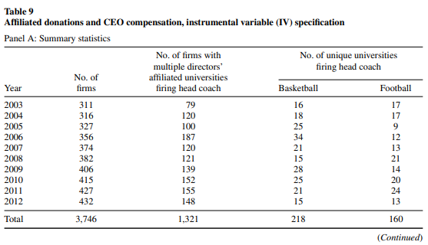
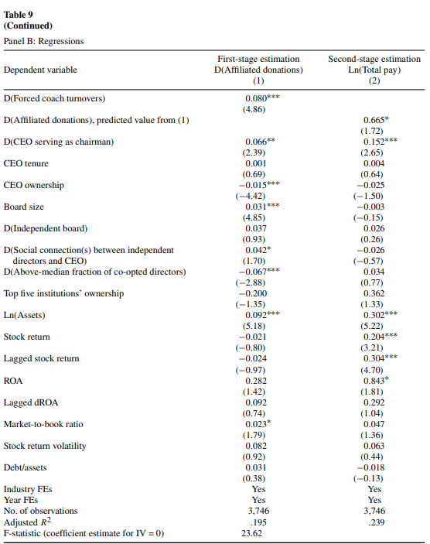
Instrumental variable specification
Notes:
Exogenous shock: a forced coach turnover
Replacing a head coach substantially increases the pressure to fundraise
Independent directors drum up contributions to universities and greatly appreciate CEOs’ understanding and financial support, which may weaken directors’ monitoring incentive
Panel A of Table 9 shows that of the 3,746 firm-year observations, 1,321 observations involve forced coach turnovers.
Column 1 of Panel B shows a strong correlation between affiliated donations and college football/basketball forced coach turnovers. The second-stage result reported in Column 2 shows the positive link between affiliated donations and CEO compensation; that is, CEO pay increases as affiliated donations increase for an exogenous reason.

Slide 18
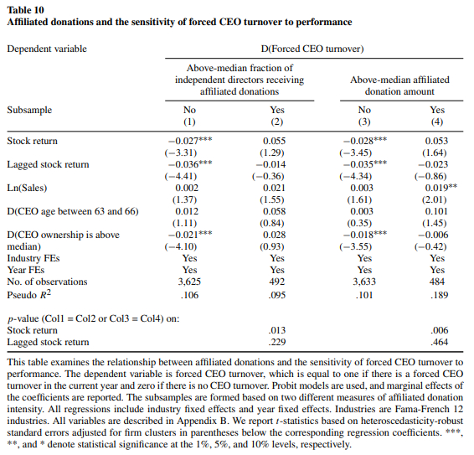
Affiliated donations and the sensitivity of forced CEO turnover to performance
Overall, making large donations or donating to a critical mass of independent directors helps poorly performing CEOs retain their jobs.
Notes:
Columns 1 and 3 shows that absent substantial affiliated donations, CEOs are more likely to be replaced when lagged and contemporaneous stock returns are poor. In contrast, columns 2 and 4 shows when a firm donates intensively to charities affiliated with independent directors, forced CEO turnover is not sensitive to stock returns.
The difference in the coefficient estimates of the contemporaneous stock return between firms with and without intensive affiliated donations is statistically significant. The difference in the turnover-to-lagged-performance sensitivity between the two groups is statistically insignificant.

Slide 19
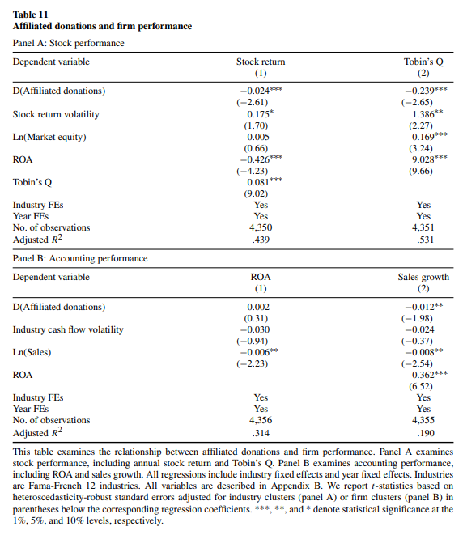




Affiliated donations and firm performance
Overall, firm performance suffers when firms make affiliated donations.
Notes:
both annual stock returns and firm value (measured by Tobin’s Q) are significantly lower when the firm makes affiliated donations. The differences are economically nontrivial. Stock return is 2.4 percentage points lower and Tobin’s Q is 0.239 lower for firms making affiliated donations than for firms not making such donations. Sales growth is also significantly lower for firms making affiliated donations (by 1.2 percentage points), and year fixed effects. ROA, however, is not significantly different between the two sets of firms.

Slide 20
Conclusions
Corporate donations to charities affiliated with independent directors reduce board monitoring effectiveness.
Excess CEO pay at firms making affiliated donations is higher than at firms not making affiliated donations
The effect of affiliated donations on CEO compensation is much stronger when the compensation committee chair or a large fraction of compensation committee members are involved.

Slide 21
Thank you!

